Slide 1
Practicum Talk: Internship at Amazon, Experiences & Thoughts
Changjian Zhang

Slide 2
Amazon BAD Organization
BAD: Bad Actor Disincentives
Identify and stop the bad actors that exploit the business flaws of Amazon to make money.
E.g., Refund flaws:
Customer A purchases a MacBook worth $2,000.
Adversarial B helps A to request refund but without return.
A pays B in a discounted price (60%) in Bitcoins.
B earns $1,200, A saves $800.

Slide 3
PSP Program
PSPP: Payment Service Provider Program
Virtual bank account (VBA) allows non-US sellers to sell on Amazon.
VBAs can be easily applied and abandoned.
The program works with VBA providers to provide real customer information for suspected VBAs.
My Team:
Build services to periodically request customer information of suspected VBAs.
Problem: Need on-demand requests support for business and other tech teams.

Slide 4


Australis: submit on-demand requests
Web UI
API Gateway
Lambda A
DynamoDB
Lambda B
SQS 1
Existing PSP request service
SQS 2
DynamoDB
Notes:
Lambda is an AWS service that supports creating serverless applications. Often, the application only involves simple computation.
SQS is another AWS service that provides a simple message queue.
DynamoDB is Amazon’s document database.

Slide 5
Australis: A Simple CRUD Application?
CRUD: Create, Read, Update, and Delete of resources.
In Australis, both Lambdas only involve CRUD:
Lambda A: write to a table.
Lambda B: read tables to gather info, then write to a table.
Such a system should be easy to implement (with well-encapsulated frameworks)?

Slide 6
What’s the side-effect of the ordering?
SQS 1
Code 1:
...
this.DynamoDBClient.save(message);
this.SQS2Client.publish(message);
...
Code 2:
...
this.SQS2Client.publish(message);
this.DynamoDBClient.save(message);
...
Lambda B
DynamoDB
SQS 2
For a Lambda function triggered by SQS, the message will become available again if the function fails, so your function code must be able to process the same message multiple times.
Notes:
If publish fails in the first case, a record in the database but no message published.
If save fails in the second case, a message is published but no record.
No, it’s not done yet. Because Lambda B is triggered by SQS, it will automatically retry.
So in first case, we may have multiple records in the database but only one published message.
In the second case, we may have multiple messages published but only one in the database.
We have to make sure no unexpected side-effects would be caused by such behavior.

Slide 7

Why my tests failed with “Rate exceeded”?
Lambda A
Error: “Lambda rate exceeded error.”
Root cause: Lambda reserved concurrency = 1
Reserved concurrency: max concurrent instances.
Lambda B invoked by SQS (from Tests A) and Tests B at the same time.
Possible solutions:
Used in similar situations: add sleep in integration tests.
Change it to an arbitrary number greater than 1.
Change it to 5?!
Tests A
SQS 1
Lambda B
Tests B
✓
https://aws.amazon.com/blogs/compute/understanding-how-aws-lambda-scales-when-subscribed-to-amazon-sqs-queues/
Notes:
From the error message, my guess is I reach the limit of allowed concurrent instances of Lambda. But it’s just a simple integration tests with less than 10 requests? Isn’t Lambda supposed to scale and handle them!
Root cause: the integration tests first test the upstream function which would later trigger the downstream function, then the tests directly invoke the downstream lambda, so the downstream lambda may have a concurrency greater than 1.

Slide 8

“It doesn’t work on my side!”
Error: Javascript “n.text is not a function.”
Fun facts:
Happened right after I presented the demo. The demo was working well!
No one in our developing team can reproduce it!
Root cause:
Wrong permission configuration.
Mismatch in configurations between two systems.
AWS Access Control
Web UI
Employee Management
Notes:
A deeper issue is: the web ui uses an AWS-based access control policy. Because this is an internal tool, we are using an internal employee management tool to define the control and need to map it back to the AWS control.

Slide 9
Takeaway 1: CRUD is not easy!
It is easy to code CRUD-like system, but bugs are often not related to code.
Actual behavior becomes hard to reason due to underlying (implicit) behaviors of the platform (e.g., retry).
Constraints and implications brought by design decisions (e.g., Lambda triggered by SQS)
Hard to reason and ensure consistency of configurations across various subsystems (e.g., permission control).

Slide 10
It doesn’t seem right, but why it works?
Why set reserved concurrency to 1?
We might be using the wrong configuration for a long while.
Why use ‘#’ in the DynamoDB field name?
A reserved keyword that should not be used in field names, even though still supported (tech debt?).
No one identified it until I encountered an issue, but it works before.
“We did this before in a similar situation, and it works well!”
“We will fix it when there’s an issue.”

Slide 11
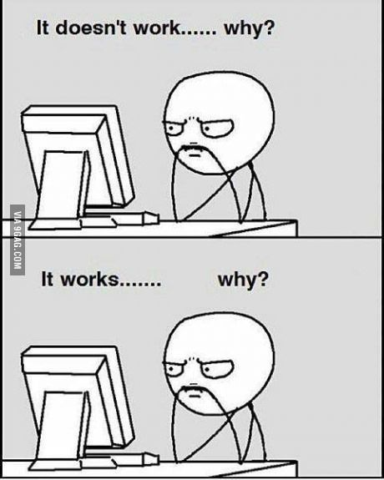
Takeaway 2: Why it Works?
Good at answering: Why it doesn’t work.
Testing, Formal verification
Google or Stack Overflow
LLMs
We often stop thinking “why it works” until it becomes a “why it doesn’t work” problem.
Requires deeper understanding of the underlying techniques (hard to tell from code).

Slide 12
Development Process
Strictly follow the Scrum process.
An emphasis on design and documentation.
Code review, static analyzers, testing to ensure code quality.
Auto CI/CD.
Planning
Developing & CI/CD
Review
Retro
Notes:
Other than some technical details, I also want to reflect on the development process.

Slide 13
But…
Meetings, Meetings, Meetings! 40% ~ 50% time in meetings!
Good for knowledge sharing but not efficient for everyone.
Great documentation on requirements, design, review, etc.
Not all the artifacts are up-to-date, some become misleading.
Often no rationales or alternatives are discussed.
Apply various techniques for ensuring code quality such as static checkers.
Sometimes conflicting configurations are found.
E.g., require using this keyword in one project but not in another.
Notes:
I’m not saying the meetings are useless. In fact, I think they are really helpful and the documentation generated from these meetings are important. However, I don’t think they are in the right format. If a lot of the engineers are working on their own jobs in a meeting, then we should rethink the format and the purpose of that meeting.

Slide 14
Takeaway 3: Engineering Practices in a Correct Way
All such activities, documentations, static checkers can indeed help improve software quality.
But not all of them are conducted correctly and effectively.
Sometimes, it becomes a burden to developers.
Notes:
Amazon conduct a pretty heavy-weight development process. It improves the software quality of course, but not in an efficient and effective way. Engineers still complain about some of the process.
This not new, that’s part of the reason why we introduce agile.

Slide 15
Moving towards the AI Era?
Amazon’s process enables:
Semi-structured documentations
Common architecture styles/patterns
Engineers produce high quality and highly similar code.
Entry-level engineers: copy and paste from existing code base, replace code templates with my logic and data models.
“I feel I’m a human when I contribute to the planning, design, review activities, and addressing issues ☺; I feel I’m a robot when I’m coding ☹.”
Notes:
When I’m clear what to work on, and after I learned the techniques I’m going to use. The coding part becomes copy-paste from existing code base. Because everyone writes the same code, understanding and finding code for similar functionality becomes easy.
Connect to my experience to show why this can be replaced by AI.

Slide 16
Moving towards the AI Era?
Extensive structured docs
AI
AWS-based architecture patterns
Highly similar code and tests
Code review, static checkers, testing
Notes:
When I’m clear what to work on, and after I learned the techniques I’m going to use. The coding part becomes copy-paste from existing code base. Because everyone writes the same code, understanding and finding code for similar functionality becomes easy.
Developers can have more time understand and reason the requirements and design.

Slide 17
Takeaway 4: How would AI make a change?
Looking ahead to the AI era: Coding vs. Generation.
A well-defined process can help improve software quality, but sometimes a burden to developers.
Will good design and documentation relief engineers from tedious coding tasks in the AI era?

Slide 18
Summary
Bugs of CRUD are often due to wrong requirements, design, config.
Fail to understand why a system works until an error occurs. Requires a deeper understanding of the underlying techniques.
An emphasis on process, design, documentation => high quality.
A burden to developers
Can AI fill the gap?

Slide 19
Formal Methods in AWS
AWS hires a lot of formal methods researchers.
Research focus:
Program analysis
Access control, Security policy
Program verification (Rust)
Distributed algorithm/protocol verification (Dafny, P)
Business rationale:
Crucial building blocks for cloud infrastructure
Complexity cannot be easily handled by engineers
Benefit > Cost
CRUD-like systems are easy?

Slide 20
Software Development Process in Amazon
Scrum process
Roles:
Manager: Scrum master
PM & BA: product owner
Engineers: Development team
2 Weeks = Sprint
3 Sprints = Feature Delivery Cycle
Planning
Developing & CI/CD
Review
Retro
Notes:
Manager controls the development process to allocate resources internally and externally, coordinate across other teams, tracking the progress, monitor team operation metrics.
PM make feature requests but won’t affect the technical decision made by the engineers.
Development team has most of the power to make the right technical decisions for features, and also estimate the effort needed for features.

Slide 21
Planning Phase
Planning
Developing & CI/CD
Review
Retro
Meetings:
Sprint planning meeting
Task grooming meeting (planning poker)
Design review meeting
Artifacts & Data:
User stories, Tasks, and Backlog
Architecture design
Development schedule
Notes:
At Amazon, they have a strong focus on system design. For every feature, an engineer is responsible for creating a design for it.

Slide 22
Developing Phase
Planning
Developing & CI/CD
Review
Retro
Meetings:
Daily standup meeting
Whiteboard design session
Development activities:
Code commits
Code review
Testing & Static Analyzers
Automated CI/CD
Artifacts & Data:
Review discussions
Testing reports

Slide 23
Code Review, Static Analyzers, and Testing
An internal code review system (like GitHub).
Static analyzers:
Java Checkstyle plugin
Java SpotBugs analyzer
Internal analyzer for dependency vulnerabilities
Amazon CodeGuru Reviewer (advertised as program analysis + ML)
Internal Risk/Security issue detection analyzer
Testing platforms for integration, load, canary tests.
Notes:
So in general, Amazon use code review, static checkers, and testing to ensure the quality of the system.

Slide 24
Scrum Review Phase
Planning
Developing & CI/CD
Review
Retro
Meetings:
Feature/Task review meeting
Feature Launch/Demo meeting
Dashboard review
Artifacts & Data:
Updated backlog
Burndown chart
Review app operation data: throughput, error rate…
SOPs: standard operation procedures

Slide 25
Scrum Retro Phase
Planning
Developing & CI/CD
Review
Retro
Meetings:
Team/Org-level retro meeting
Administrative meeting
Artifacts & Data:
Kudos & Action items
Review team operation data:
Tickets
Risks
Development activities metrics (e.g., number of manual deploys)
Notes:
Retro is a great time to reflect how the team can improve the development process. Story: I was developing using a tool new to the team, so I follow the documented step to manually deploy the code to the beta phase. It triggers a warning in the team operation metrics that there was a spike in the number of manual deployment, which was 0 in the past.
Instead of just letting not manually deploy or turn off the warning, the team researched how this metric is collected, is it reasonable, and can we let it ignore manual deployment for projects that are not in production.

Slide 26
How Agile Manifesto is Respected?
Individuals and interactions over processes and tools
Interactions and communications via various meetings, whiteboard sessions, pair programming.
But also processes and tools to support communication, logging, knowledge sharing.
Need interactions but also keep them in record!
Working software over comprehensive documentation
Surprisingly more documents than you would expect, Wiki, design doc, planning & tracking docs, SOPs.
Various testing, static analysis, CI/CD support to ensure quality and facilitate fast delivery.
Notes:
1. So its

Slide 27
How Agile Manifesto is Respected?
Customer collaboration over contract negotiation
Customer Obsession.
Team B is Team A’s customer; Away Team.
Responding to change over following a plan
Business plan (OP1, OP2) over development plan.
Feature take-in time window.
More like incremental development but review the plan every two weeks.

Slide 28
Conway’s Law and More…
Organization structure defines system design.
Everything (including business goal, management, development process, tooling, …) defines the code.
By following the process, everyone produces the same, high-quality code. (Interestingly, you won’t find comments on code.)
Notes:
Code as comment is the result of design doc, meetings, design patterns, strict code standard, and static checkers.
The use of Lambda and serverless is the result of logically simple program needs to run in scale.
The change in organization structure is the result of change in business goal, e.g., BAD has extended its business functionality from only addressing bad actors.

Slide 29
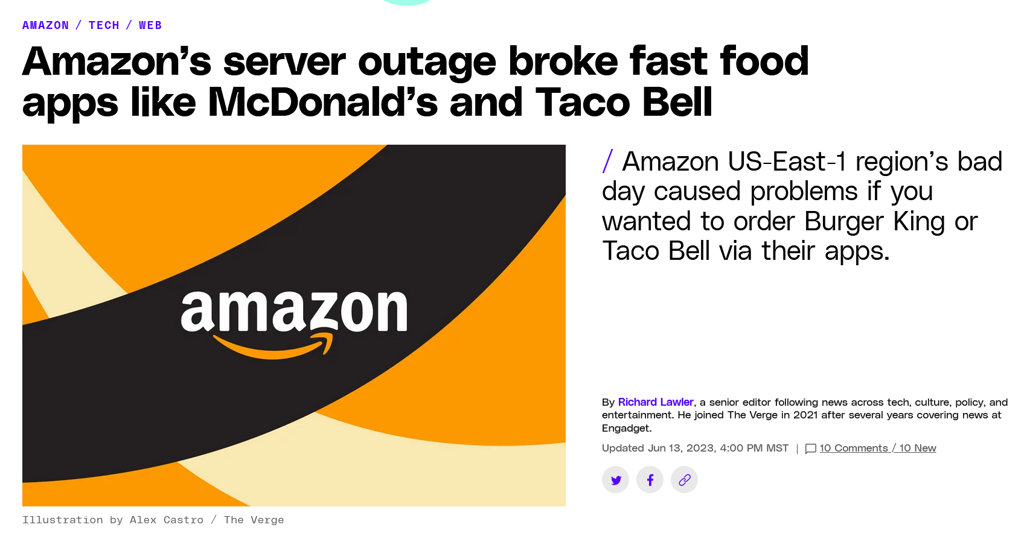
AWS Outage on Jun 13, 2023
Notes:
A lot of internal services as well as customer services are affected. Nightmare for oncall engineers, but at the same time, a lot of interns (some full-time engineers) are posting memes in the Slack channel. Ironically, later, Slack was also affected and some of its services were in degraded mode. Not sure if this was related to increasing volume of Slack because of the memes, but…
Even more memes were posted LOL.

Slide 30
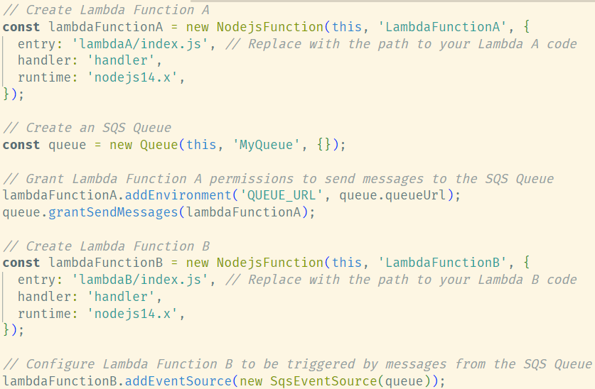


IaC to AaC?
Lambda A
MyQueue
Lambda B

Slide 31
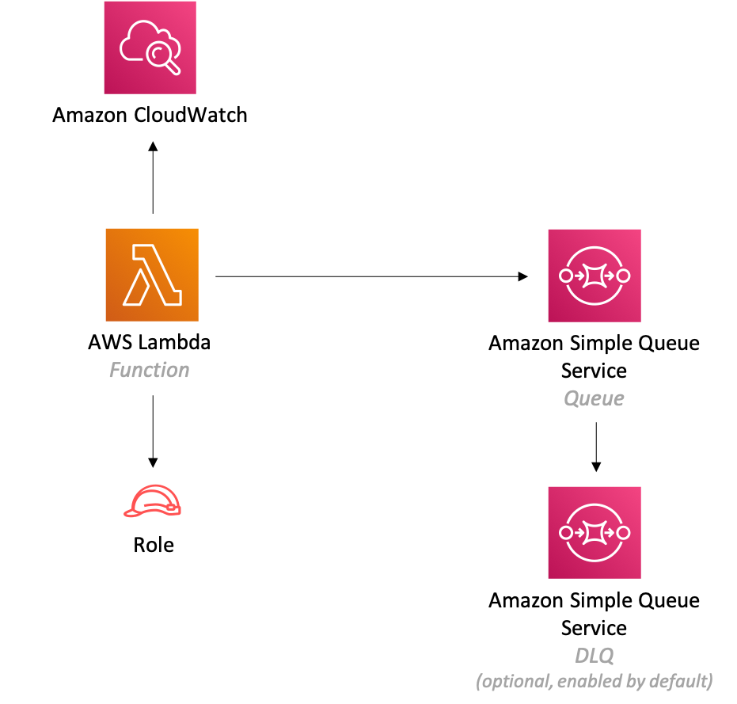
A Typical AWS Lambda Architecture

Slide 32

But it is hard!
Make us happy when build the system.
Make it a nightmare when debug the system!

